Slide 1
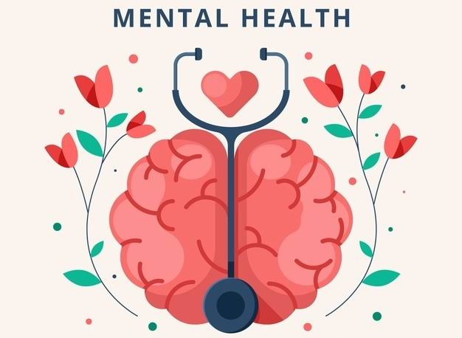
Teen Mental Health

Slide 2
Teen depression and anxiety
Depression
ANXIETY

Slide 3
Depression--Some warning signs in teens
Persistent sadness
Withdrawal from friends and activities once enjoyed
Slowed thinking, speaking, bodily movements, it “feels best” to be alone and isolated; low energy
Anger, irritability or agitation
Trouble getting along with people
Feeling negative and worthless, self-criticism
Feeling misunderstood and extremely sensitive
Inability to tolerate stress or adversity
Difficulty in concentration
Sense that life and the future are bleak; hopelessness
Poor school performance or attendance
Changes in eating, sleeping, and grooming habits,
Use of drugs and/or alcohol or other risky behaviors
Self-harm

Slide 4
Anxiety--Some warning signs in teens
Recurring fears and worries about routine parts of everyday life
Crippling concern about something in the future or the future in general
Excessive worry about social acceptance
Restless, feeling keyed up, on edge
Changes in behavior, such as irritability
Avoiding activities, school, or social interactions
Dropping grades or school avoidance
Trouble sleeping or concentrating
Chronic physical complaints, such as muscle tension, fatigue, headaches, or stomachaches
Panic attacks; episodes of sudden intense fear
Substance use or other risky behaviors

Slide 5
The special life and brain of the teen
Synaptic growth enhances moral development and openness to new experiences and ideas; enhanced dopamine activity
The limbic system (fear, emotional impulses) matures before the prefrontal cortex (planning ahead, emotional regulation). That means the instinctual and emotional areas develop before the reflective ones do.

Slide 6
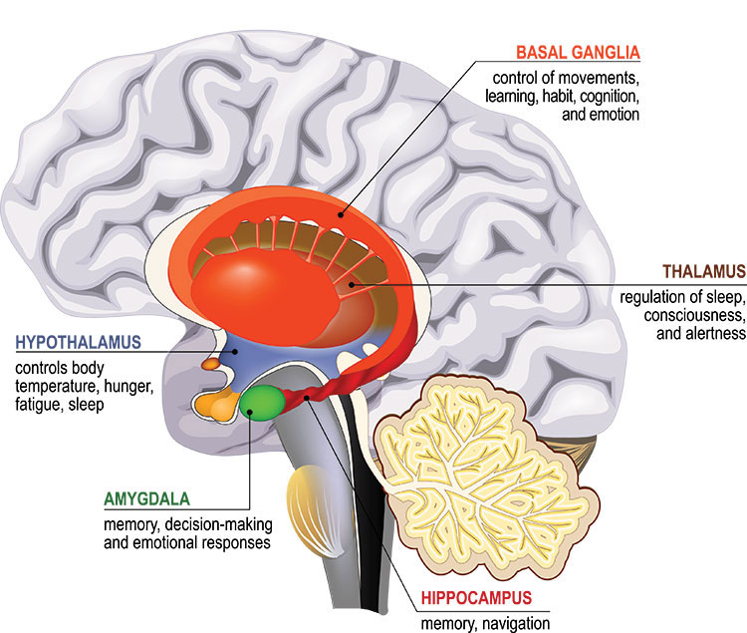
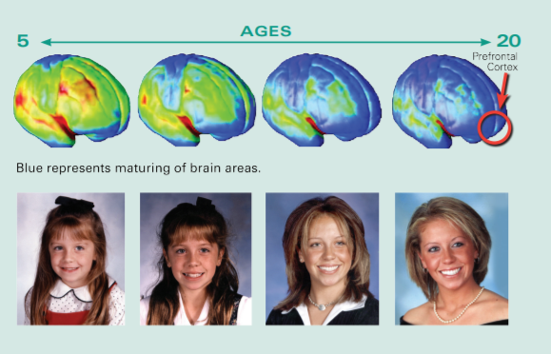
The special life and brain of the teen

Slide 7
The special life and brain of the teen
The adolescent brain’s “reward center”: Identity/independence AND peer/friend approval.
When emotions are intense, especially involving the “reward center”, the logical part of the brain “shuts down”.

Slide 8
The special life and brain of the teen
When stress, arousal, passion, sensory bombardment, drug intoxication, or deprivation is extreme, the adolescent “thinking” brain can be overwhelmed.
Other general characteristics of teens’ thinking:
Egocentrism
Personal fable
Imaginary audience

Slide 9
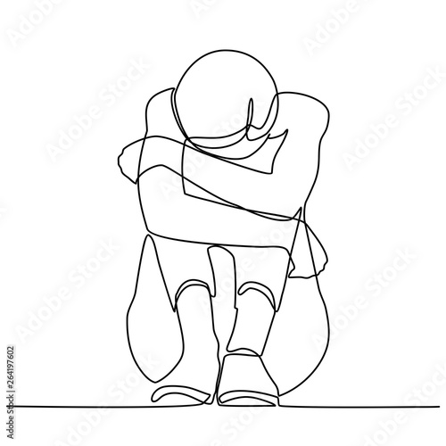
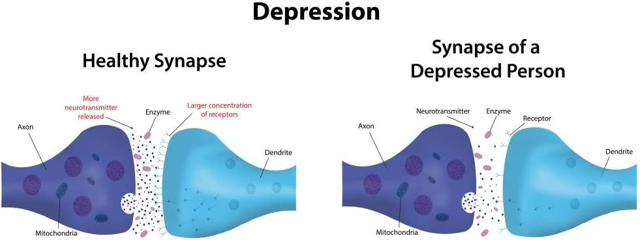

Slide 11
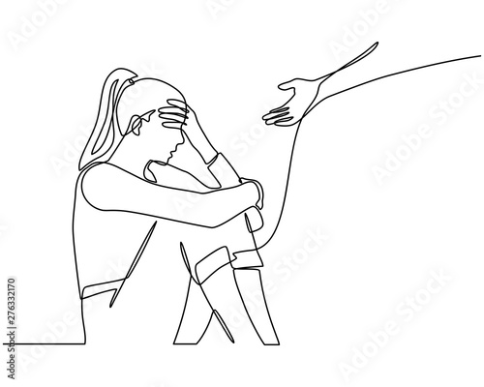
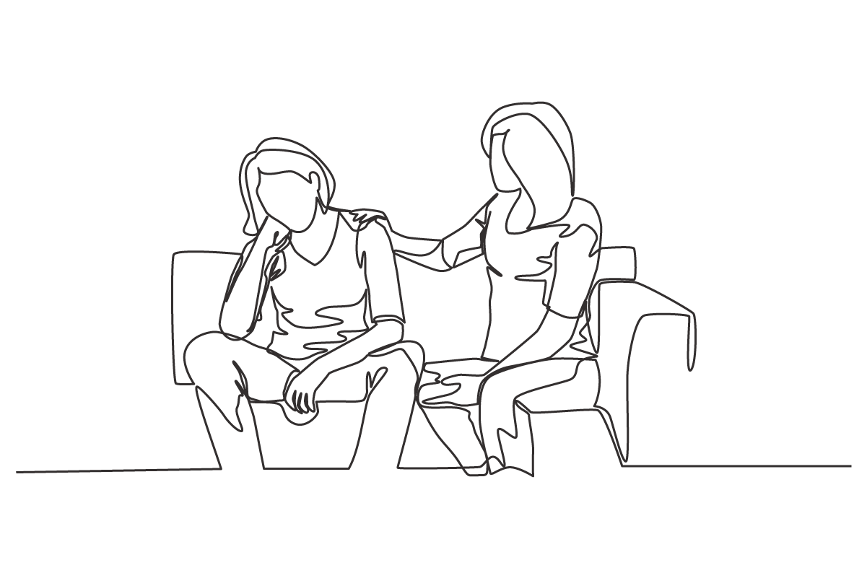
Coming alongside
2 Corinthians 7:5-7; 2 Corinthians 1:3-5
Help in articulation and expression (Integration)
= words, expressions, etc.
Someone who gets it
Someone who gets it
Hopeless-ness, Despair, Worry
Someone who gets it
Someone who gets it

Slide 12
Coming alongside
“Inspire to rewire” (Siegel, 2014); Love heals (literally!) Model openly talking about mental health and model problem-solving.
Bridges to hear the heart.
Actions and words that can bridge from fear/worry/depression into hope:
Presence
Family routines
Open questions/asking permission
Asking for metaphors/peers’ experiences
Supplying the words and checking
Activities together (“shoulder to shoulder”)
“Rewriting” together the troubling thoughts
Together finding the next steps, more resources, tools, people, things that can be changed
Ask for help (be aware of warning signs of suicide ideation)

Slide 13
Warning signs of suicide ideation
Always talking or thinking about death
Death wish
Losing interest in things once cared about
Comments about being hopeless or worthless
Putting affairs in order
Statements like “It would be better if I wasn’t here”
“Good-byes”
Appearing as if depression is subsiding
Having a plan
Previous attempts
Friends who have attempted
Writing a note

Slide 14
Some resources
ALL the resources in the Lord, His Word, His Spirit and His people
https://www.focusonthefamily.com/get-help/mental-health-resources/
SAMHSA’s national helpline (Substance abuse and mental health services administration)
1-800-662-HELP (4357)
Christian Counseling Centers in the area
Example: Lighthouse Counseling; Solace Counseling
Have crisis hotline numbers: National = 1-800-273-8255; Waconia = 952-442-7601;

